Slide 1
Capstone 2
CertificationExperience

Slide 2
وش الفكرة؟
وش المشكلة؟
وش بتستفيد كا مستخدم للبرنامج ؟

Slide 3
First Endpoint: Add Booking
URL: POST /api/v1/BOOKING/ADD/{readerId}/{zoomSessionId}
Method: POST
Path Variables:
readerId (Integer) – ID of the reader making the booking.
zoomSessionId (Integer) – ID of the Zoom session to be booked.
📄 Description: This endpoint creates a new booking for a specific Zoom session by a given reader. It checks that the reader and session exist, verifies the session is available and hasn’t started yet, ensures the reader hasn’t already booked it, and confirms the reader’s wallet has sufficient balance. If all checks pass, the session price is deducted from the reader’s wallet, the booking is confirmed, and the session is marked as unavailable for others.

Slide 4
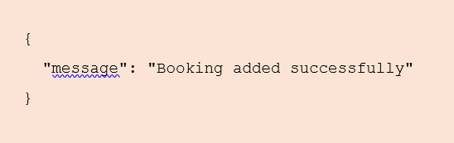
Success Response (200 OK):
Returns a confirmation message indicating the booking was successful.

Slide 5
Second Endpoint: Get All Bookings for Reader
URL: GET /api/v1/BOOKING/GET/{readerId}
Method: GET
Path Variable:
readerId (Integer) – ID of the reader whose bookings are being retrieved.
📄 Description: This endpoint retrieves all bookings made by a specific reader. It first verifies that the reader exists in the system and then returns a list of all their bookings. This is useful for displaying a reader’s booking history or upcoming reservations.

Slide 6
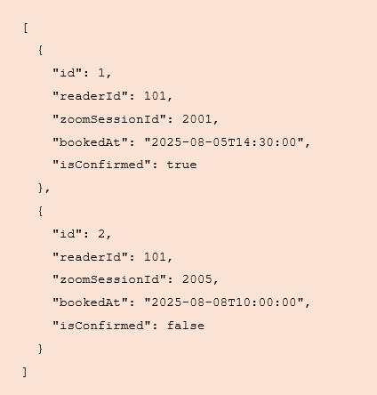
Success Response (200 OK):
Returns a list of bookings (as JSON) associated with the given reader ID.

Slide 7
Third Endpoint: Delete Booking
URL: DELETE /api/v1/BOOKING/DELETE/{readerId}/{bookingId}
Method: DELETE
Path Variables:
readerId (Integer) – ID of the reader who owns the booking.
bookingId (Integer) – ID of the booking to be deleted.
📄 Description: This endpoint deletes a specific booking for a given reader. It ensures that the reader exists, verifies that the booking exists and belongs to the reader, and checks that the session linked to the booking has not yet started. If all validations pass, the booking is deleted and the associated Zoom session is marked as available again.

Slide 8
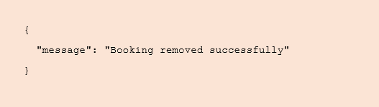
Success Response (200 OK):
Returns a confirmation message indicating the booking was successfully removed.

Slide 9
Fourth Endpoint: Toggle Session Availability
URL: PUT /api/v1/SESSION/TOGGLE/{contributorId}/{sessionId}/{available}
Method: PUT
Path Variables:
contributorId (Integer) – ID of the contributor who owns the session.
sessionId (Integer) – ID of the session to update.
available (boolean) – true to make the session available, false to disable it.
📄 Description: This endpoint toggles the availability status of a Zoom session. It verifies that the contributor exists and owns the session, ensures the session hasn’t started yet, and enforces a 2-hour buffer before the start time when enabling availability. When enabling, it also checks that there are no existing bookings for the session.

Slide 10
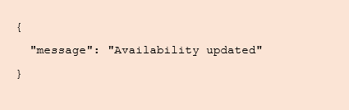
Success Response (200 OK):

Slide 11
Fifth Endpoint: GET EXPERIENCES WITH SCORE ABOVE X
URL: GET /api/v1/experience/score-above/{score}
Method: GET
Path Variables:
score (Double) — Minimum score threshold; returns experiences with scoreAchieved greater than this value.
📜 Description:
Retrieves all certification experiences where scoreAchieved is strictly greater than the specified score. Useful for users who want to browse high-performing or top-scoring experiences.

Slide 12
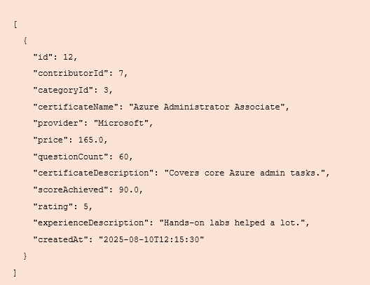
Success Response (200 OK):

Slide 13
Sixth Endpoint: Get Sessions by Contributor
URL: GET /api/v1/SESSION/GET/BY-CONTRIBUTOR/{contributorId}
Method: GET
Path Variable:
contributorId (Integer) – ID of the contributor whose sessions are being retrieved.
📄 Description: This endpoint returns all Zoom sessions created by a specific contributor. It verifies that the contributor exists in the system before retrieving the list of their sessions.

Slide 14
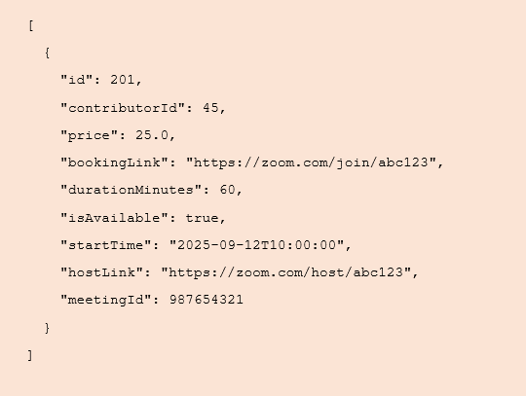
Success Response (200 OK):
Returns a JSON array of ZoomSession objects owned by the specified contributor.
json

Slide 15
SEVENTH Endpoint: Get Certification Experiences by Category
URL: GET /api/v1/experience/by-category/{categoryId}
Method: GET
Path Variables:
categoryId (Integer) – ID of the category to filter experiences by.
📄 Description: This endpoint retrieves all certification experiences that belong to a specific category. It first validates that the category exists, then returns a list of experiences associated with that category. Useful for displaying all certificates within a particular domain or specialization.

Slide 16
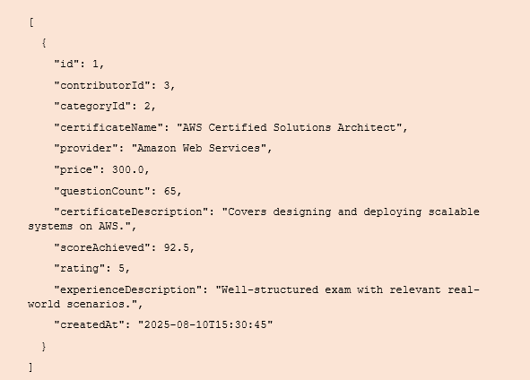
Success Response (200 OK):

Slide 17
Eighth Endpoint: Get All Reviews by Reader
URL: GET /api/v1/REVIEW/GET/BY-READER/{readerId}
Method: GET
Path Variable:
readerId (Integer) — ID of the reader whose reviews should be returned.
📄 Description: This endpoint retrieves all reviews written by a specific reader. The service first verifies that the reader exists, then returns the list. Useful for a “My Reviews” page.

Slide 18
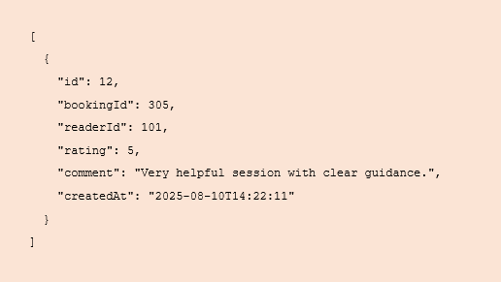
Success Response (200 OK):

Slide 19
NINTH Endpoint: Get Reviews by Contributor
URL: GET /api/v1/REVIEW/GET/BY-CONTRIBUTOR/{contributorId}
Method: GET
Path Variable:
contributorId (Integer) — ID of the contributor (session owner)
📄 Description:
Returns all reviews written for sessions owned by the specified contributor. The service validates the contributor exists, fetches their sessions, finds bookings for those sessions, then returns the reviews linked to those bookings.

Slide 20
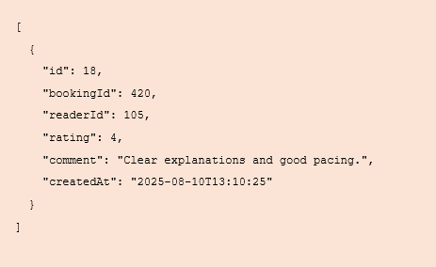
Success Response (200 OK):

Slide 21
10TH Endpoint: Get Experiences by Contributor
URL: GET /api/v1/experience/by-contributor/{contributorId}
Method: GET
Path Variable:
contriAbutorId (Integer) — ID of the contributor.
📄 Description: Returns all certification experiences created by the specified contributor. The service validates the contributor exists, then fetches and returns their experiences.

Slide 22
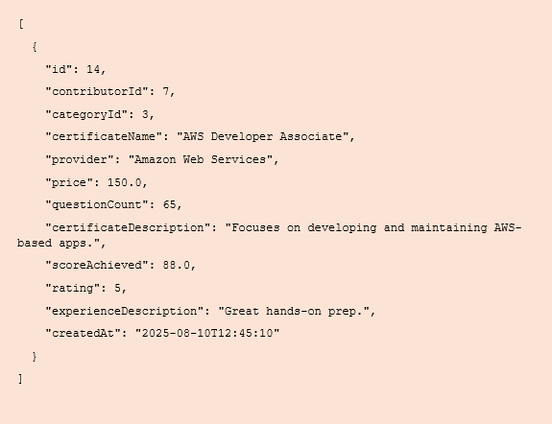
Success Response (200 OK):

Slide 23
11TH Endpoint: Review Summary for Session
URL: GET /api/v1/REVIEW/SUMMARY/SESSION/{sessionId}
Method: GET
Path Variable:
sessionId (Integer) — ID of the Zoom session.
Returns a compact summary of the reviews for a specific session:
averageRating — the arithmetic mean of all ratings for bookings of this session.
count — how many reviews exist.
How it works under the hood:
Verifies the session exists.
Fetches all bookings for that session.
Collects reviews tied to those bookings and computes the average rating and total count.

Slide 24
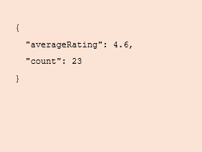
Success Response (200 OK):

Slide 25
12TH Endpoint: Can Book Session (Eligibility Check)
URL: GET /api/v1/BOOKING/CAN-BOOK/{readerId}/{sessionId}
Method: GET
Path Variables:
readerId (Integer) — ID of the reader.
sessionId (Integer) — ID of the Zoom session.
📄 Description: Checks whether the specified reader can book the given session right now. Validations include: reader & session existence, session not started, session availability, no prior booking by the same reader, session not already booked, and sufficient wallet balance.

Slide 26
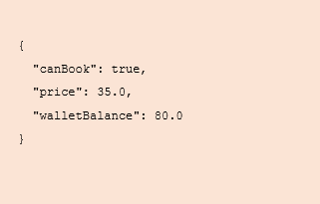
Success Response (200 OK):

Slide 27
13TH Endpoint: Get Experiences by Provider
URL: GET /api/v1/experience/by-provider/{provider}
Method: GET
Path Variable:
provider (String) — e.g., AWS, Microsoft, Google.
Description: Returns all certification experiences published under the specified provider (case-insensitive). Useful to list all certificates from a single vendor.

Slide 28
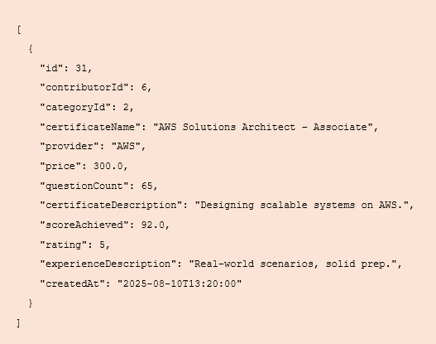
Success Response (200 OK):

Slide 29
14TH Endpoint: Certification Experiences by Price Range
URL: GET /api/v1/experience/by-price/{min}/{max}
Method: GET
Path Variables:
min (Double) — minimum price (≥ 0).
max (Double) — maximum price (must be ≥ min).
📄 Description: Returns all certification experiences whose price is between min and max (inclusive). Useful for letting users browse certificates that fit their budget.

Slide 30
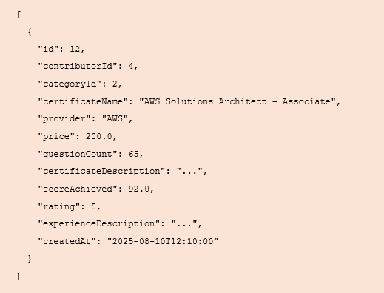
Success Response (200 OK):

Slide 31
15TH Endpoint: Certification Experiences by Question Count
URL: GET /api/v1/experience/by-questions/{min}/{max}
Method: GET
Path Variables:
min (Integer) — minimum number of questions (≥ 1).
max (Integer) — maximum number of questions (must be ≥ min).
📄 Description: Returns all certification experiences whose questionCount is between min and max (inclusive). Helpful when users want exams with a certain workload.

Slide 32
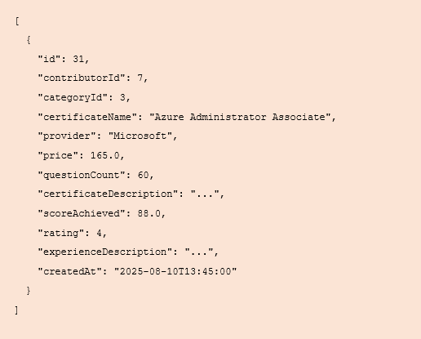
Success Response (200 OK):

